Slide 1
Sergio.Baranzini@ucsf.edu

Slide 2
Prepare software and files
Download PLINK1.9 for Windows OS 32bit from
https://www.cog-genomics.org/plink2
Download R v2.3.0 from http://cran.r-project.org/bin/windows/base/
In the R terminal, write: install.packages (“qqman”)
Create folder: GWAS
Copy exercise files into folder GWAS

Slide 3
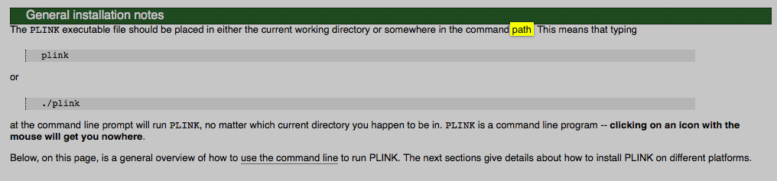
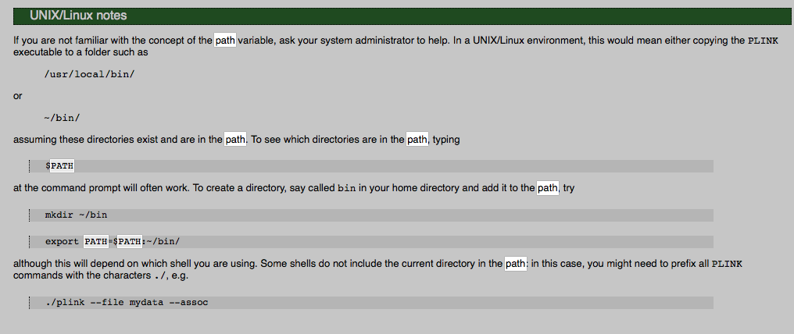
Installation notes

Slide 4
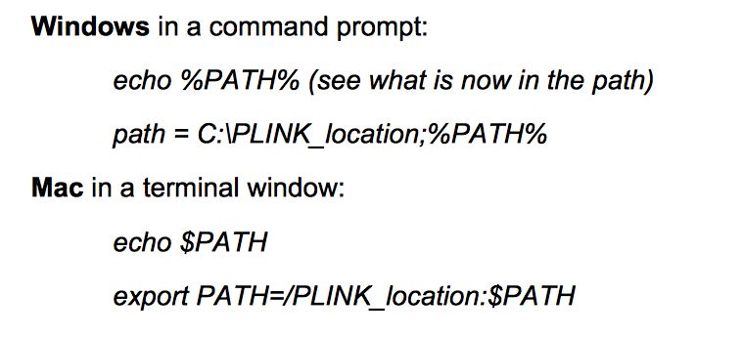
If the previous does not work…

Slide 5
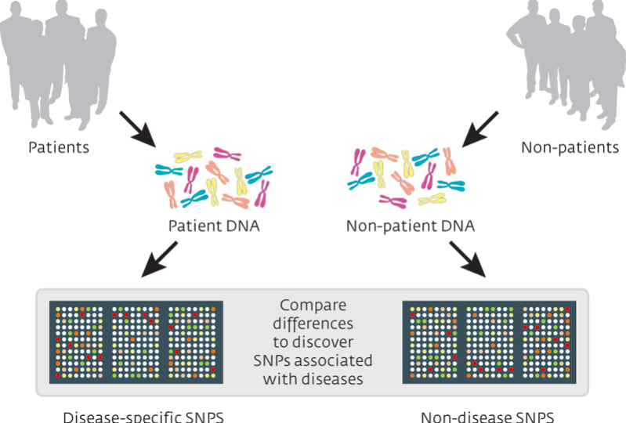
Overview of GWAS

Slide 6
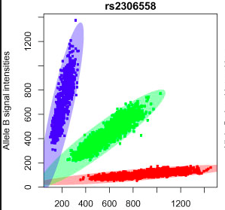
Fluorescence -> numbers

Slide 7
Data set
Rheumatoid Arthritis case:control study
868 cases and 1194 are controls
569 males, 1493 females
545,080 SNPs

Slide 8
PLINK file types
.fam → PLINK sample information file
Family_id within-family_id WF_Id (father) WF_id (mother) sex phenotype
D0024949 D0024949 0 0 2 1
D0024302 D0024302 0 0 1 1
D0023151 D0023151 0 0 1 2
D0022042 D0022042 0 0 2 2
.bim → PLINK extended MAP file
Chr SNP_id cM bp coord ma MA
1 snp1 0 1 G A
1 snp2 0 2 T G
1 snp3 0 3 A C
.bed → PLINK binary biallelic genotype table
0x6c 0x1b 0x01 0xdc 0x0f 0xe7 0x0f 0x6b 0x01

Slide 9
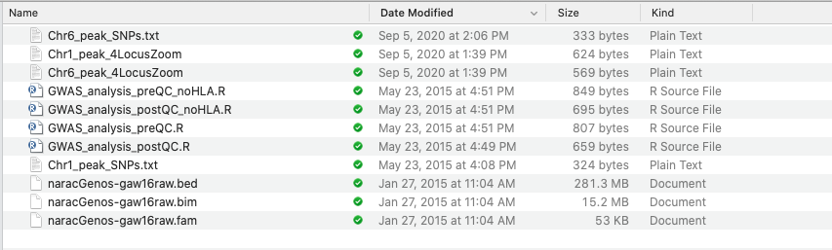
Useful files

Slide 10
Pipeline
Red: PLINK commands
Blue: R commands
Green: useful file names
1. Open a terminal (cmd) window and navigate to the directory where the PLINK data files (.bed, .bim and .fam) are stored
2. plink --bfile naracGenos-gaw16raw --logistic --adjust --gc --out narac_assoc_pre-QC: Generates narac_assoc_pre-QC.assoc.logistic (association file pre-QC)
3. Open R terminal and navigate to the data directory. Type source (“GWAS_analysis_preQC.r”)
4. Look for and analyze the plots preQC_Manahattan.png and preQC_qqPlot.png
5. Take note of the genomic inflation parameter (lamda) (find it in the plink.log file).

Slide 11
Pipeline (continued)
Removing the HLA region
6. plink --bfile naracGenos-gaw16raw --exclude-snps rs2894066-rs2499757 --logistic --adjust --gc --out narac_assoc_pre-QC_noHLA: Generates narac_assoc_pre-QC_noHLA (association file pre-QC without HLA region)
7. Open R terminal and navigate to the data directory. Type source (“GWAS_analysis_preQC_noHLA.r”)
8. Look for and analyze the plots preQC_Manahattan_noHLA.png and preQC_qqPlot_noHLA.png
9. Take note of the genomic inflation parameter (lamda).

Slide 12
Pipeline (continued)
Cleaning the dataset
10. plink --bfile naracGenos-gaw16raw --mind 0.03 --geno 0.01 --hwe 0.00000057 --make-bed --out cleaned_mind_geno_hwe: Eliminates people with more than 3% missing genotypes, SNPs with more than 1% missingness, HWE < 5.7 1E-7, and creates a new set of files called “cleaned_mind_geno_hwe.xxx”
11. plink --bfile cleaned_mind_geno_hwe --genome --out naracGenome: Generates a .genome file for IBD computations
12. plink --bfile cleaned_mind_geno_hwe --read-genome naracGenome.genome --cluster --mds-plot 10: Generates plink.mds file with first 10 components for pop stratification plots
13. Load plink.mds file in R by typing:
mds <- read.table(“plink.mds”, header = TRUE) and visualize components in scatter plot by typing: plot (mds$C1, mds$C2)
14. plink --bfile cleaned_mind_geno_hwe --pca 10 header: Generates plink.eigenval and plink.eigenvec for using PC as covariates

Slide 13
Pipeline (continued)
Run proper association test
15. plink --bfile cleaned_mind_geno_hwe --logistic --adjust --gc --covar plink.eigenvec --covar-name PC1,PC2,PC3 --hide-covar --out narac_assoc_covar_pca: performs association test (logistic regression) using first 3 PC as covariates
16. Go to R terminal and type source (“GWAS_analysis_postQC.r”)
17. Look for and analyze the plots postQC_Manahattan.png and postQC_qqPlot.png
18. Take note of the genomic inflation parameter (lamda)

Slide 14
Pipeline (continued)
Removing the HLA region
18. plink --bfile cleaned_mind_geno_hwe --exclude-snps rs2894066-rs2499757 --logistic --adjust --gc --covar plink.eigenvec --covar-name PC1,PC2,PC3 --hide-covar --out narac_assoc_covar_pca_noHLA: performs association test (logistic regression) using first 3 PC as covariates without HLA region
19. Go to R terminal and type source (“GWAS_analysis_postQC_noHLA.r”)
20. Look for and analyze the plots postQC_Manahattan_noHLA.png and postQC_qqPlot_noHLA.png

Slide 15
Pipeline (continued)
Looking closer at candidate SNPs
21. Read SNP of interest from Chr1_peak_SNPs into R:
22. Chr1_peak <- readLines (‘Chr1_peak_SNPs.txt’)
23. manhattan(narac_postQC2, highlight = Chr1_peak)
24. zoom and highlight SNPs of interest
25. manhattan(subset(narac_postQC2, CHR == 1), highlight = Chr1_peak, xlim = c(110000000, 120000000), main = "Chr 1 peak”)
Xlim for Chr6 SNPs is (50000, 500000)

Slide 16
Pipeline (continued)
Evaluating Regional association Plots for candidate regions
26. Go to: http://locuszoom.org/genform.php?type=yourdata
27. In Path to Your File, load the file: “Chr6_peak_4LocusZoom.txt”
28. In SNP: type “rs12203592”
29. Click: Plot your Data
30. Open the generated file (EUR.rs…..)
31. Search the web for associations between this SNP/gene and Rheumatoid arthritis

Slide 17
Pipeline (continued)
Evaluating Regional association Plots for candidate regions
32. Repeat steps 27-31 using the file “Chr1_peak_4SNAP.txt” and in SNP : type “rs2476601”
33. Search the web for associations between this SNP/gene and Rheumatoid arthritis
CONGRATULATIONS!

